Slide 1
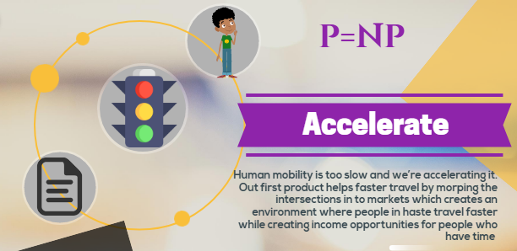
Notes:
Is this actually possible? How can you change a road or an intersection in to a market?

Slide 2
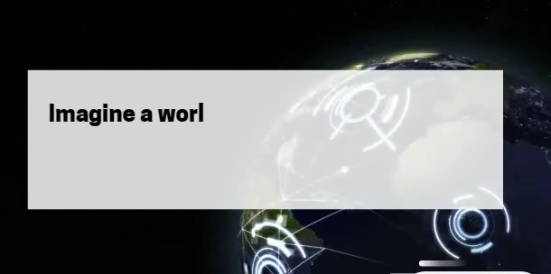

Slide 3
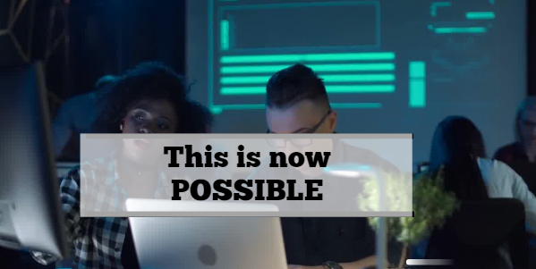

Slide 4
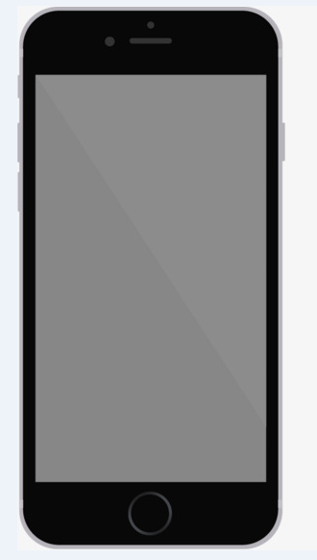
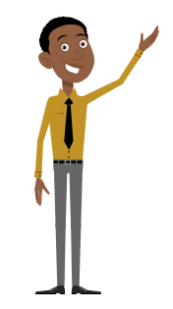
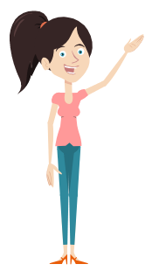
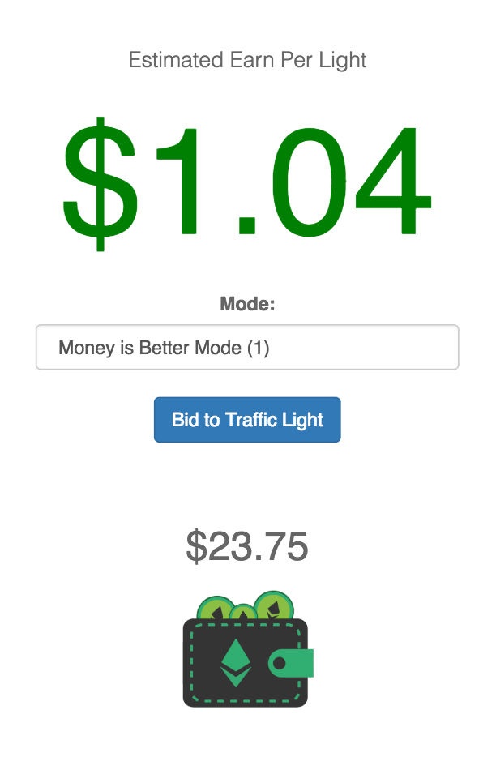
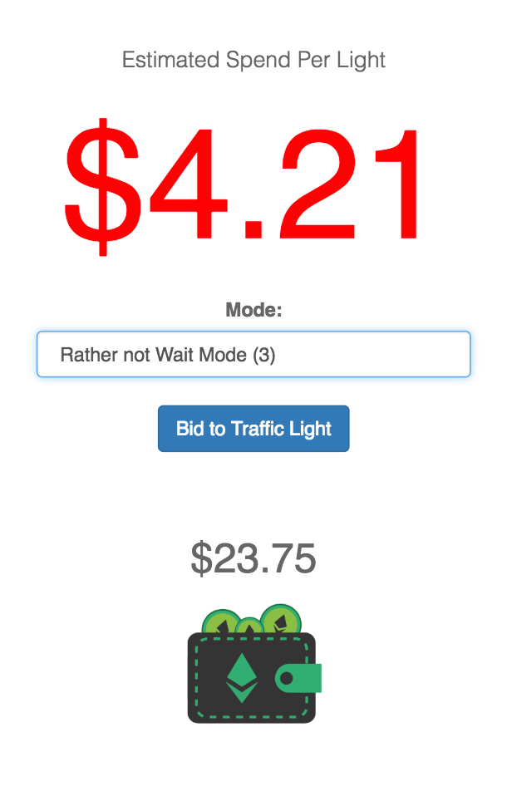
ALICE
BOB
Notes:
Meet Alıce & Bob.

Slide 5
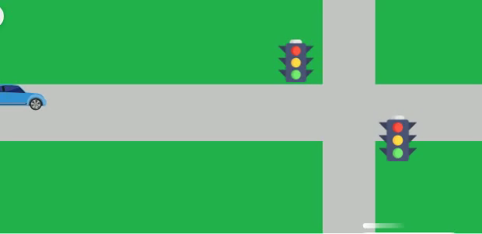
TRAFİK SİMÜLASYONU

Slide 6
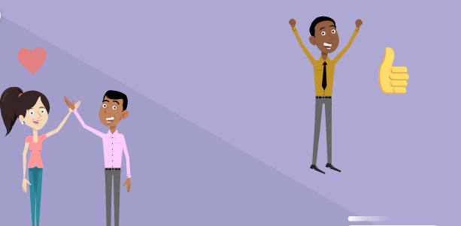
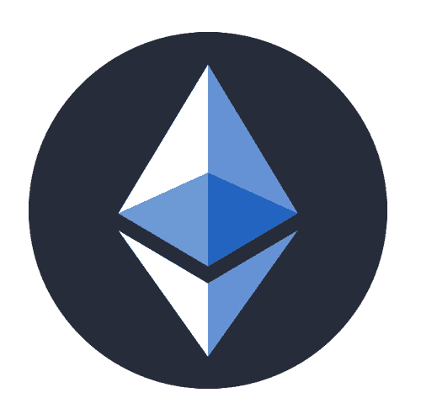

Slide 7
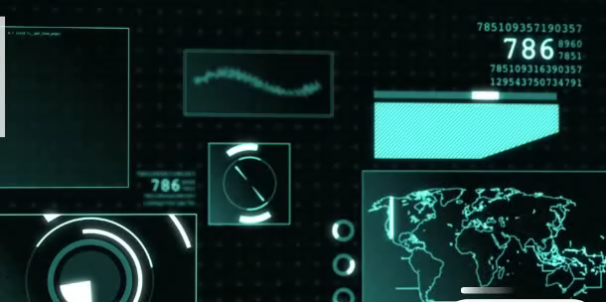
Konuyla ilgili tüm geçmiş bilgiler.
Artık geçerli olmayan özgün varsayımlar.
Notes:
Overall

Slide 8
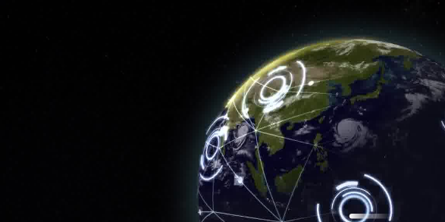
Etherium Blockchain
Mercedes API
Infura API
Scalable
Decentralized
Sustainable

Slide 9
For FUTURE
Freight Transportation
Pedestrians
Public Benefit (Police Ambulance..)
Encourage Public Transit & Carpooling
Foam (proof of location)
Autonomous Cars

